Slide 1
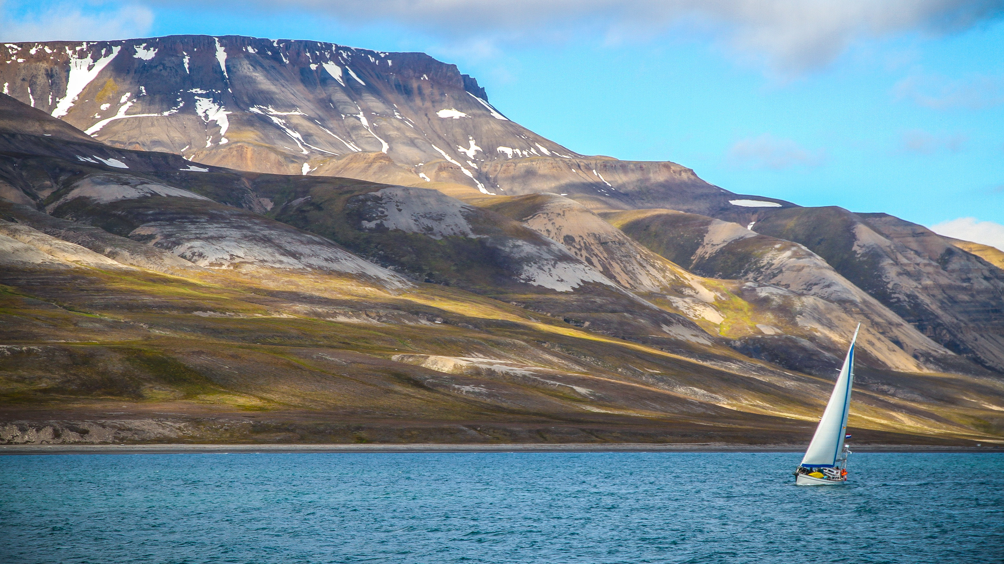
Moffat bay marina & lodge BRAVO TEAM
Brittany Kyncl & Mark Witt
CSD-460 (Software Dev Capstone)
9/27/23

Slide 2
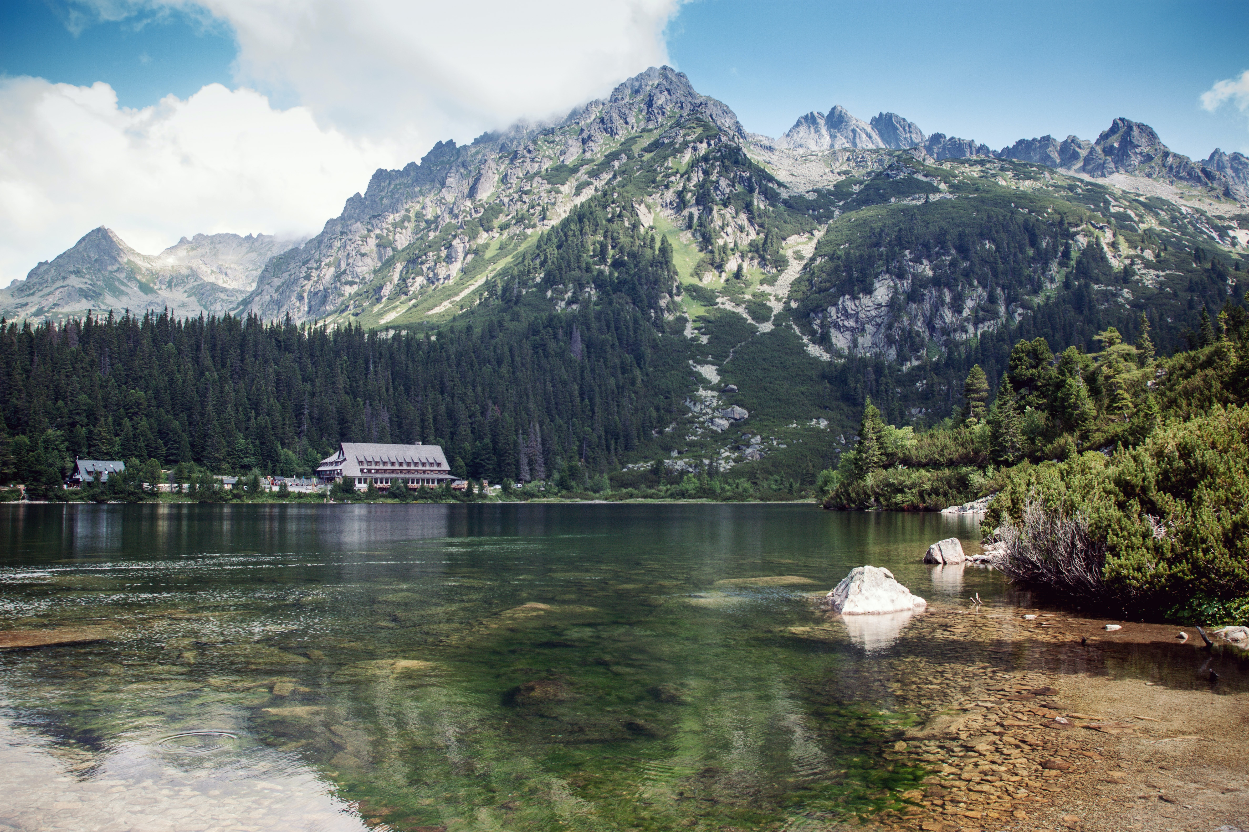

To see it in action Explore the live site here…
HTTPS://MOFFAT-BAY.ORG/

Slide 3
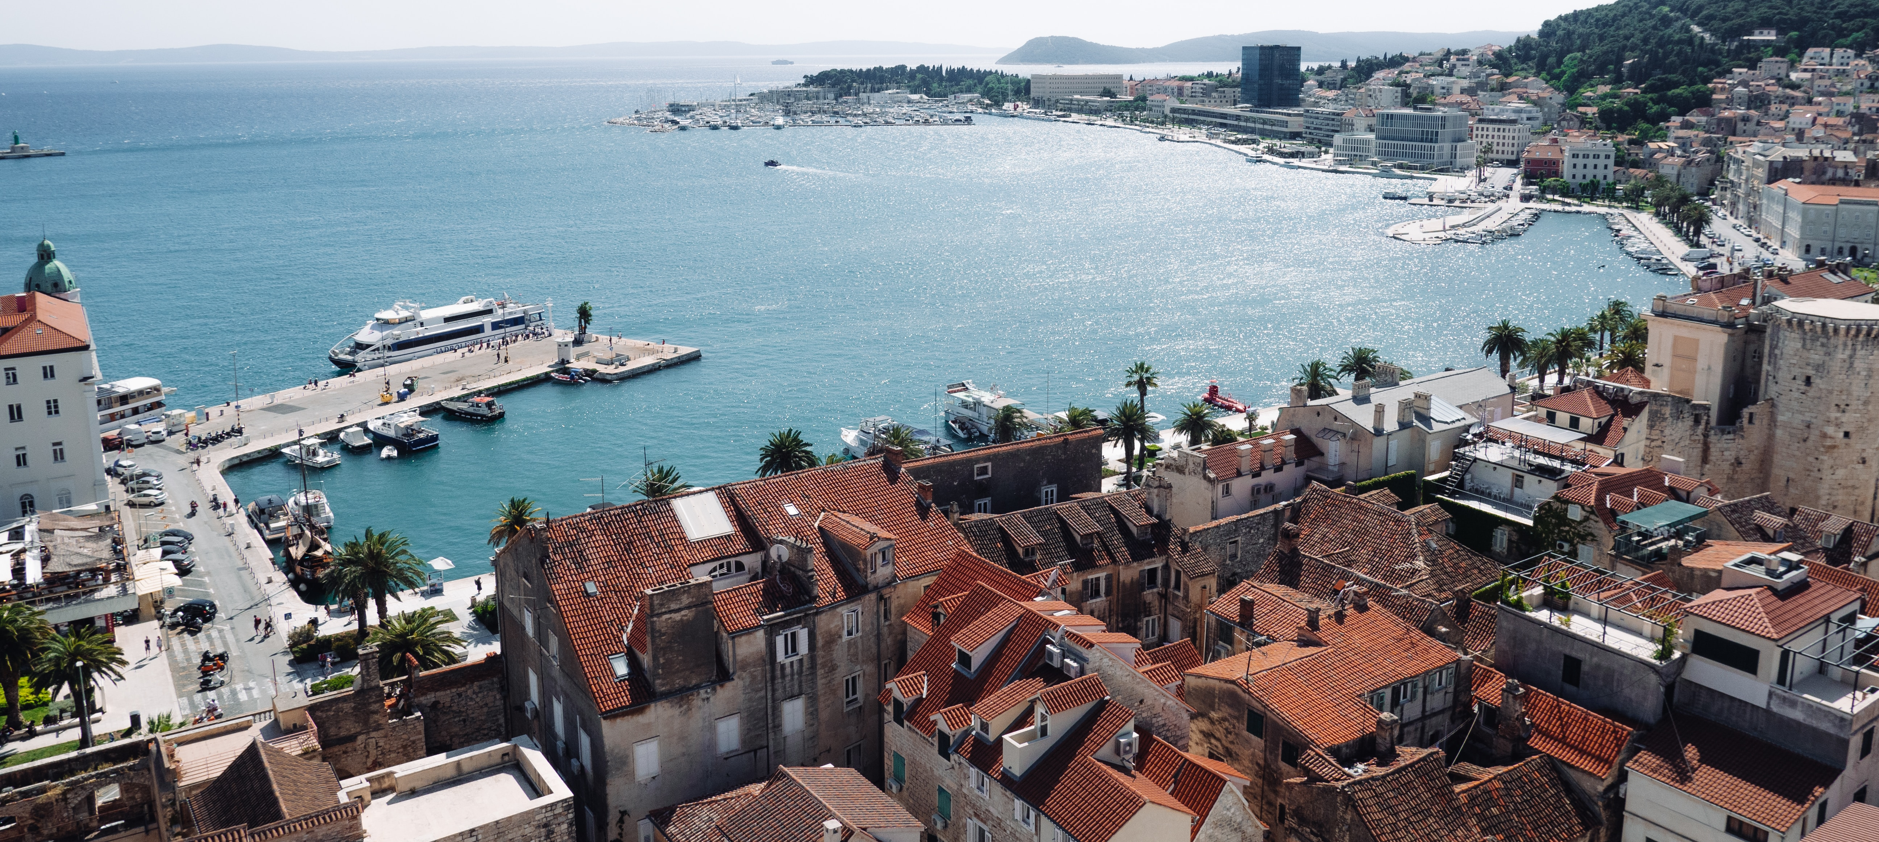

MEET THE BRAVO TEAM
Mark Witt
Brittany Kyncl
Role: Developer
Mark is a result driven developer with sharp focus on performance and functionality. With a passion for turning ideas into digital realities. His expertise and problem-solving skills has been instrumental in ensuring that every aspect of the site functions flawlessly.
Role: Developer
Brittany is a user-centric developer dedicated to crafting engaging and visually stunning user interfaces. With a keen eye for detail and creative design. Her expertise and creative flair has been essential in crafting a seamless and visually appealing website for Moffat Bay Lodge.

Slide 4
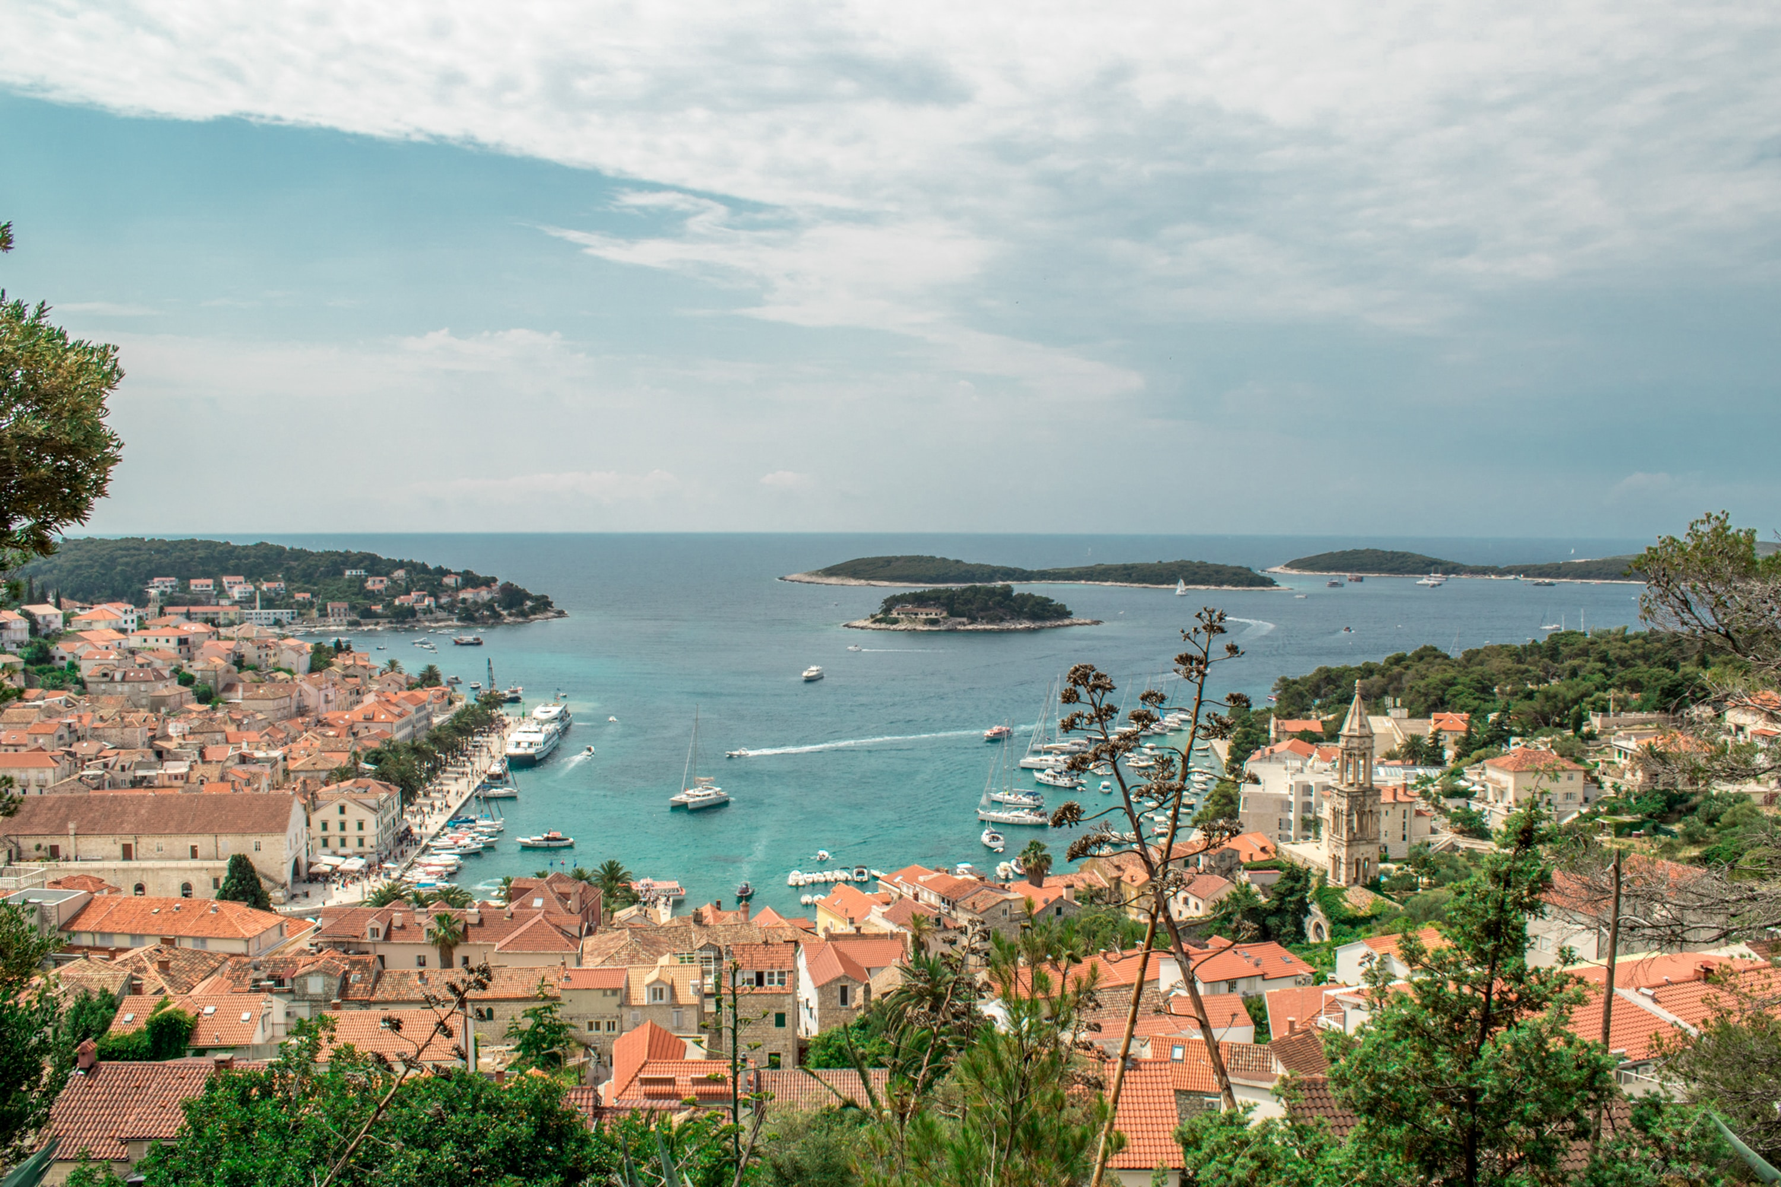
Moffat bay marina & lodge Sample prototypes

Slide 5
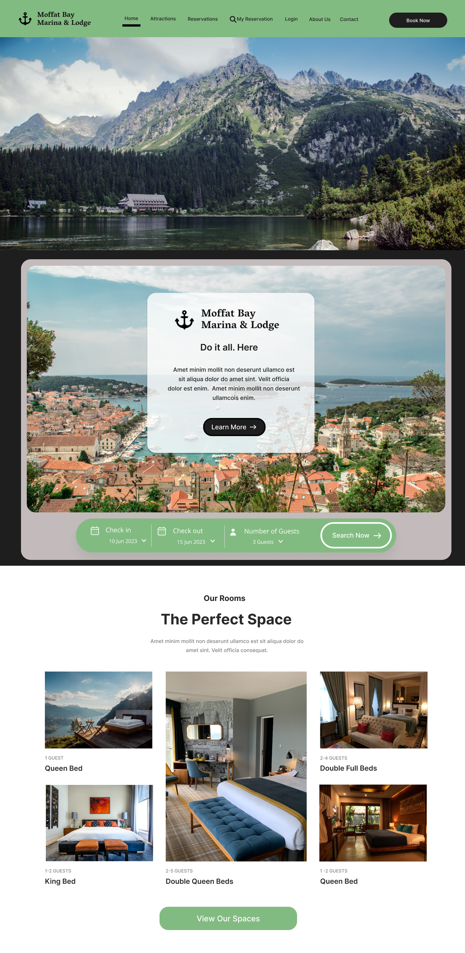
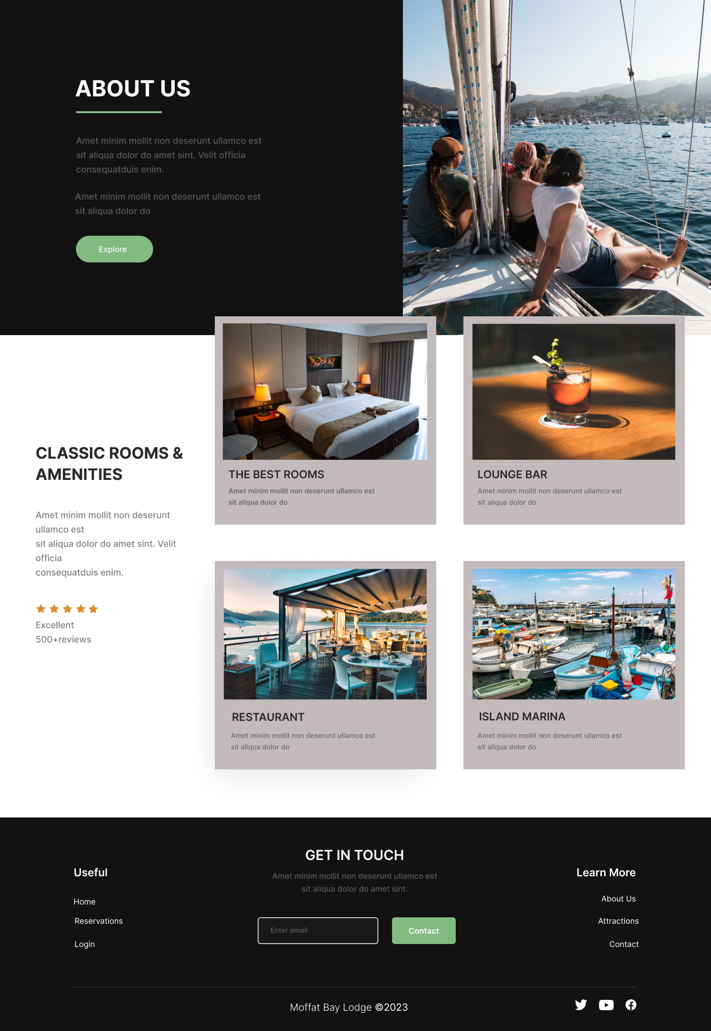
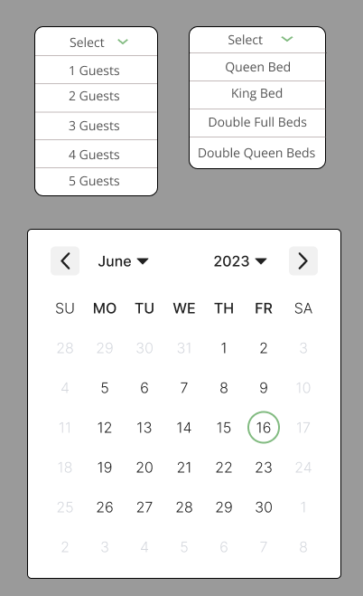
Landing page
This landing page prototype offers a visual representation of what visitors will first see when they visit the site.
Key Elements & Design
Navigation Header: At the top you’ll notice our logo representing the brand. The navigation menu offers clear and intuitive links to the various site pages.
Call to Action: A prominent “Book Now” button invites visitors to explore the reservation system.
Image Header: A striking image header showcasing the lodge’s picturesque setting.
Information Box: An informative text box provides a concise overview of what the lodge has to offer. The “Learn More” button encourages visitors to view the attractions page.
Room Search: A user friendly search field allows guests to search available rooms by date and number of guests.
Room Gallery: A gallery section provides attractive images of our rooms. Enticing visitors to explore further by clicking the “View Our Spaces” button.
About Us: An informative section detailing what the lodge is all about. Inviting visitors to learn more by clicking the “Explore” button to view the about us page.
Highlights Gallery: An intriguing and modern highlights gallery showcases they key highlights of the lodge. Including rooms, lounge gar, restaurant, and island marina.

Slide 6
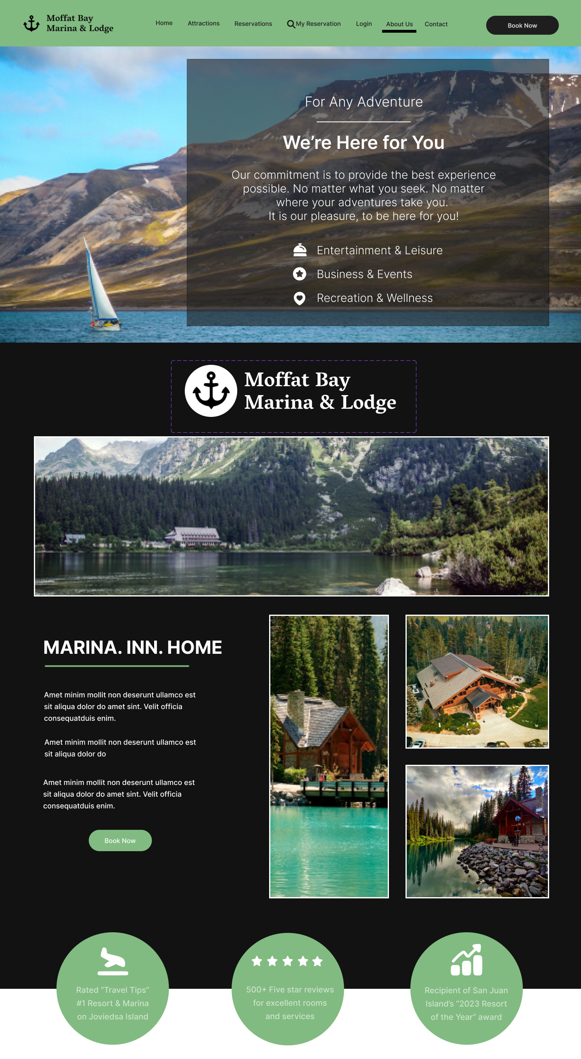
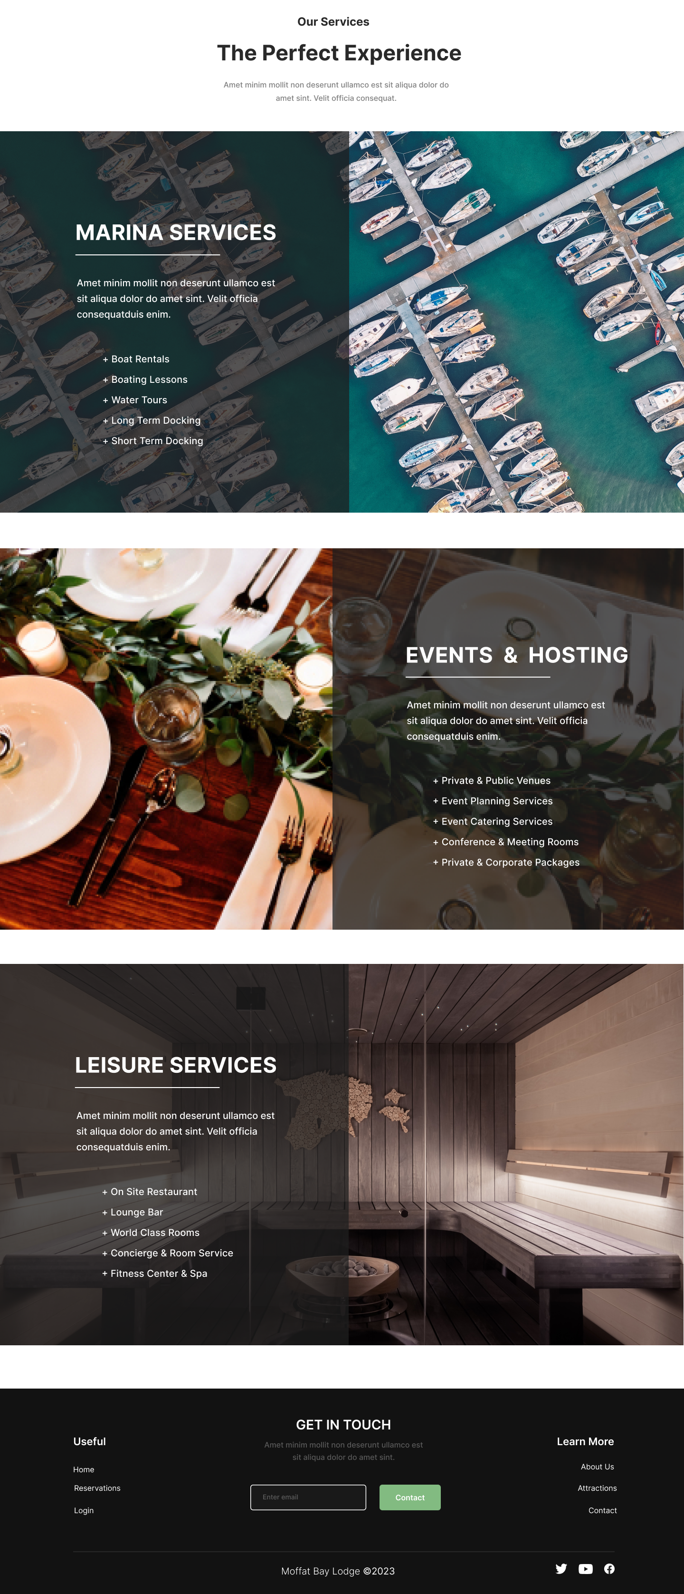
About Us page
This about us page prototype offers a glimpse into the identity and commitment of Moffat Bay Lodge.
Key Elements & Design
Navigation Header: At the top, a consistent navigation header.
Commitment Message: A captivating image header features a prominent text box displaying a commitment message.
Prominent Branding: A similar logo variant is prominently displayed under the commitment message, establishing the brand identity of the lodge.
Lodge Showcase: A gallery section with stunning lodge images with an informative narrative revealing more about the lodge.
Call to Action: The “Book Now” button encourages visitors to transition to the reservation system.
Services Highlights: A comprehensive list of services is presented in attractive and easy to follow sections.
Services Details: Each section provides detailed descriptions of each service. Highlighting a specific aspect such as the marina, events and hosting, or leisure services.
Footer: Providing convenient navigation links and an email sign up form inviting visitors to join mailing list.

Slide 7
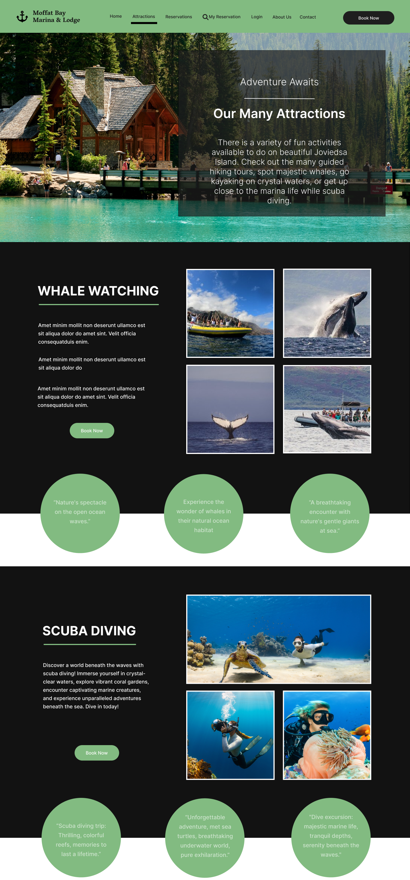
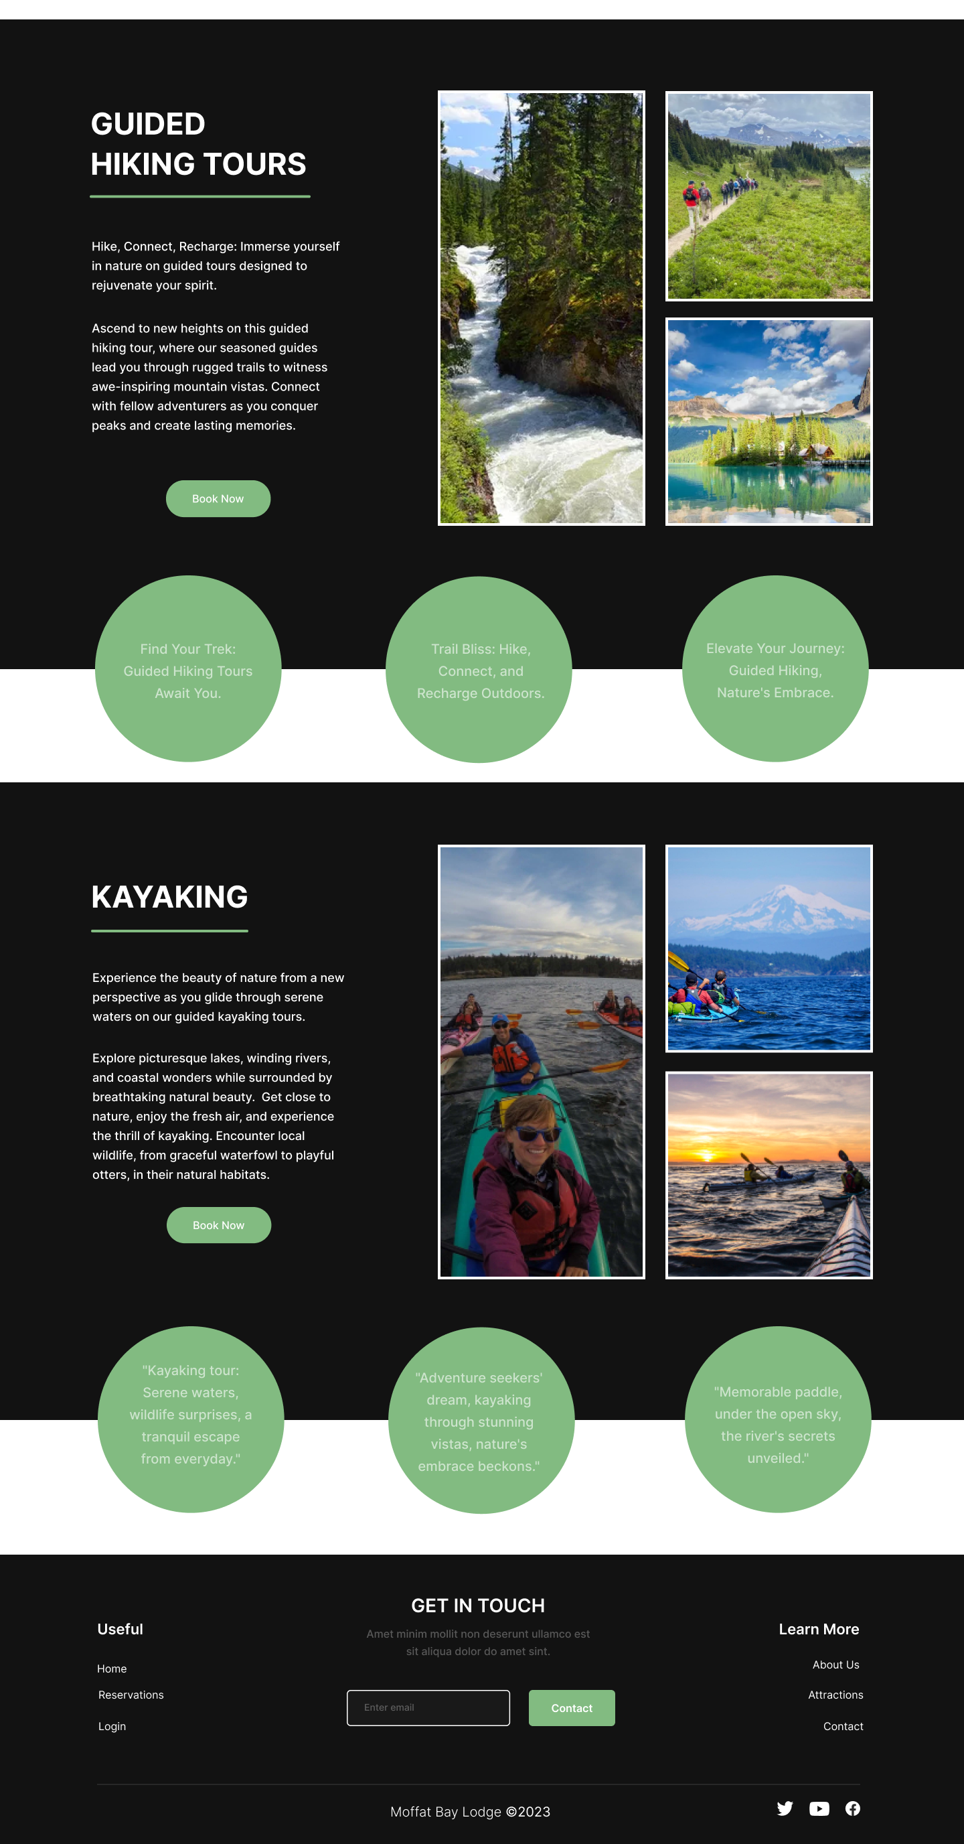
Attractions page
This attractions page prototype is designed to be an informative and exciting overview of the experiences available at Moffat Bay.
Key Elements & Design
Navigation Header: At the top, a consistent navigation header.
Image Header with Attractions Overview: A scenic image of the lodge with overlaid text. Providing an enticing overview of nearby attractions
Call to Action: The “Book Now” button encourages visitors to transition to the reservation system.
Attractions Sections: Each attraction is presented sequentially in their own sleek and striking section. With vibrant a vibrant image gallery, reviews, and informational text.
Whale Watching: Design section, text overview, and gallery dedicated to whale watching.
Scuba Diving: Design section, text overview, and gallery dedicated to scuba diving.
Guided Hiking Tours: Design section, text overview, and gallery dedicated to hiking tours.
Kayaking: Design section, text overview, and gallery dedicated to kayaking.
Footer: Providing convenient navigation links and an email sign up form inviting visitors to join mailing list.

Slide 8
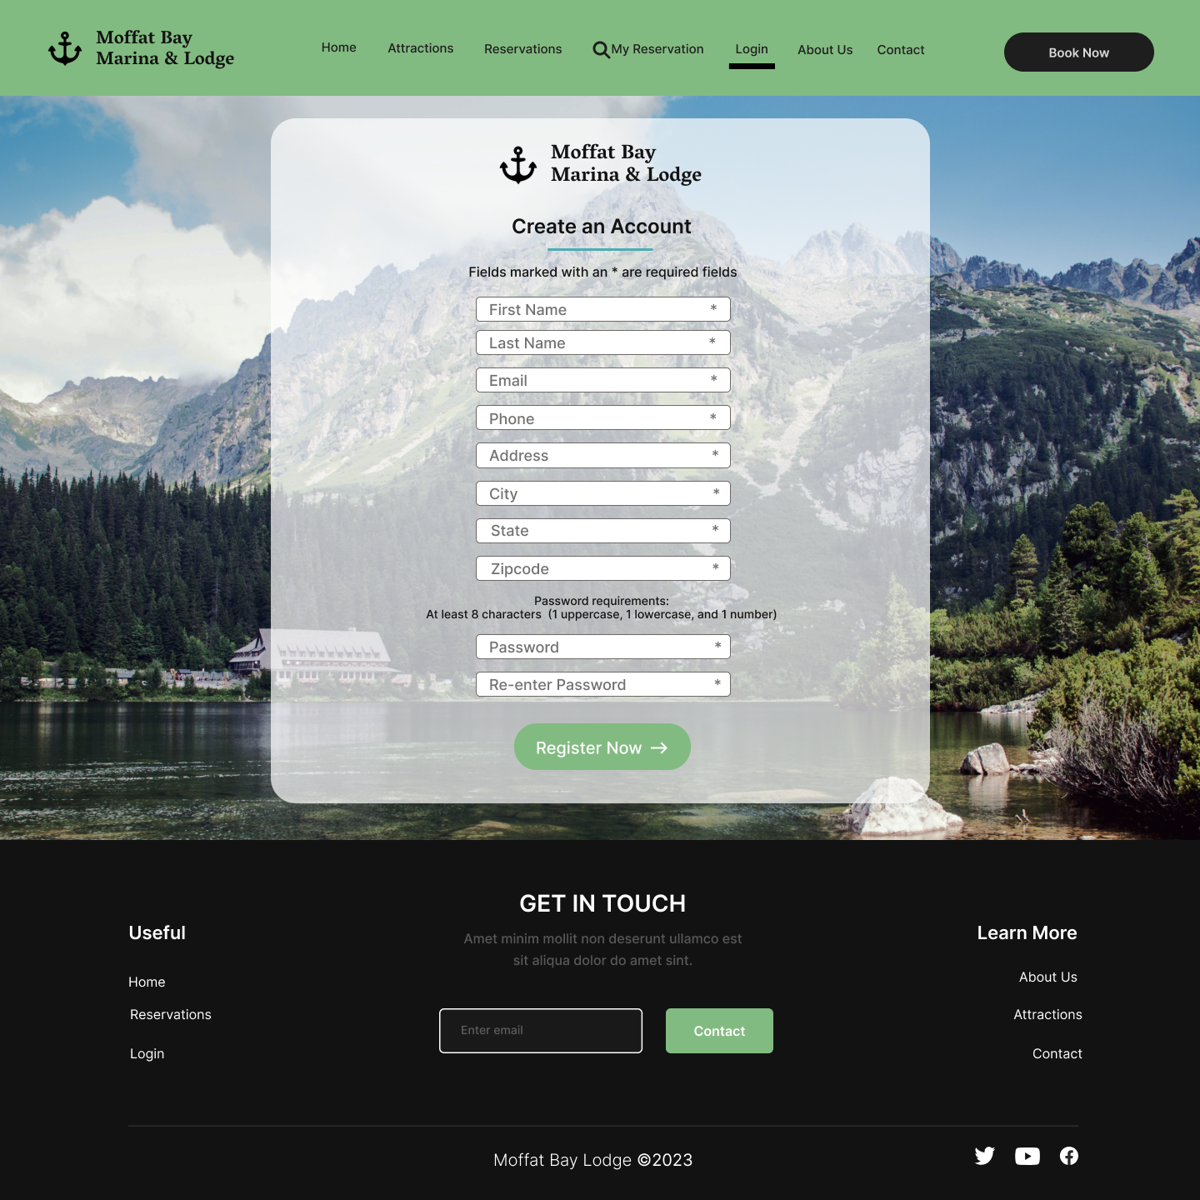
registration page
This registration page prototype offers a visual representation of user registration for the site.
Key Elements & Design
Navigation Header: At the top, a consistent navigation header.
Call to Action: The “Book Now” button encourages visitors to transition to the reservation system.
Prominent Branding: Our logo is prominently displayed in the form, reinforcing brand identity and trust.
User Registration Form: The central focus of the page is the user friendly and attractive registration form. Its intuitive design helps streamline the registration process. Indicators mark the mandatory fields.
Input Fields & Labels: Each field is accompanied by clear labeling, making it easy for users to understand and complete the requirements.
Password Requirements: Clear and concise instructions for password requirement are provided. Enhancing the security of user accounts by ensuring secure and strong passwords are created.
Register Now Button: The “Register Now” button serves as a clear indicator, prompting users to complete their registration.
Footer: Providing convenient navigation links and an email sign up form inviting visitors to join mailing list.

Slide 9
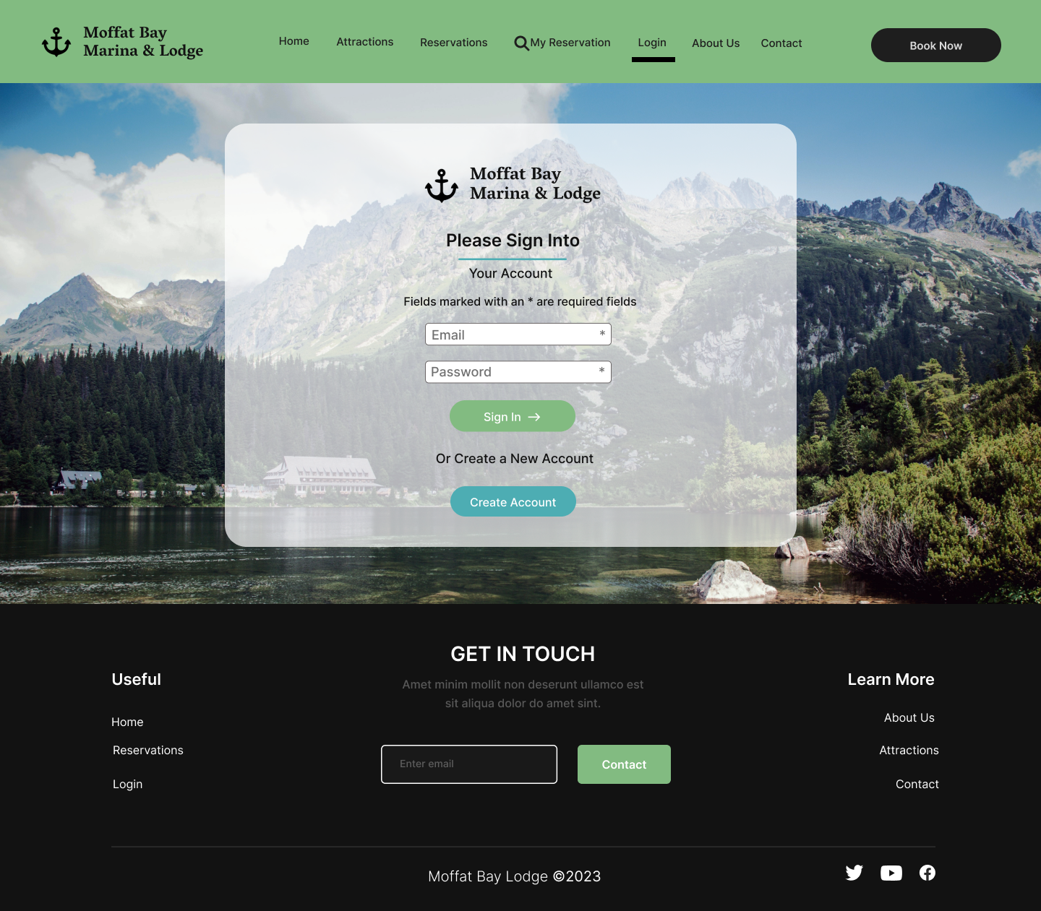
login page
This login page prototype offers a visual representation of the secure and convenient login for users.
Key Elements & Design
Navigation Header: At the top, a consistent navigation header.
Call to Action: The “Book Now” button encourages visitors to transition to the reservation system.
Prominent Branding: Our logo is prominently displayed in the form, reinforcing brand identity and trust.
Login Form: The central focus of the page is the simple and attractive login form. Designed to simplify the login process. Indicators mark the mandatory fields.
Input Fields & Labels: Each field is accompanied by clear labeling, making it effortless for users to enter in their information.
Sign-In Button: Visually appealing “Sign-In” button stands out as a clear indication, prompting users to complete the login process.
Create Account Button: The “Create Account” button is provided for users who do not have an existing account. Redirecting them to the registration page, encouraging new users to join our community.
Footer: Providing convenient navigation links and an email sign up form inviting visitors to join mailing list.

Slide 10
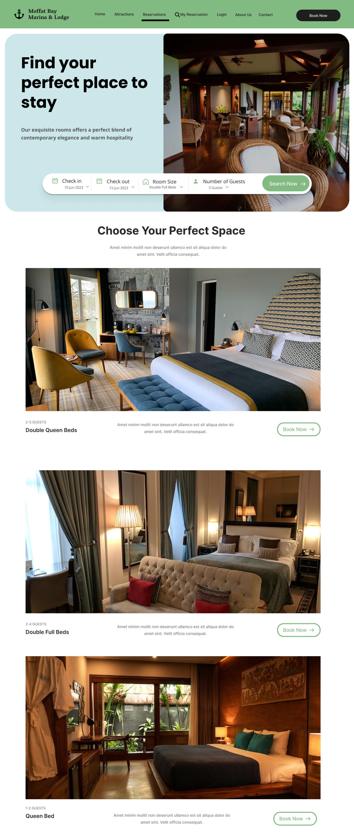
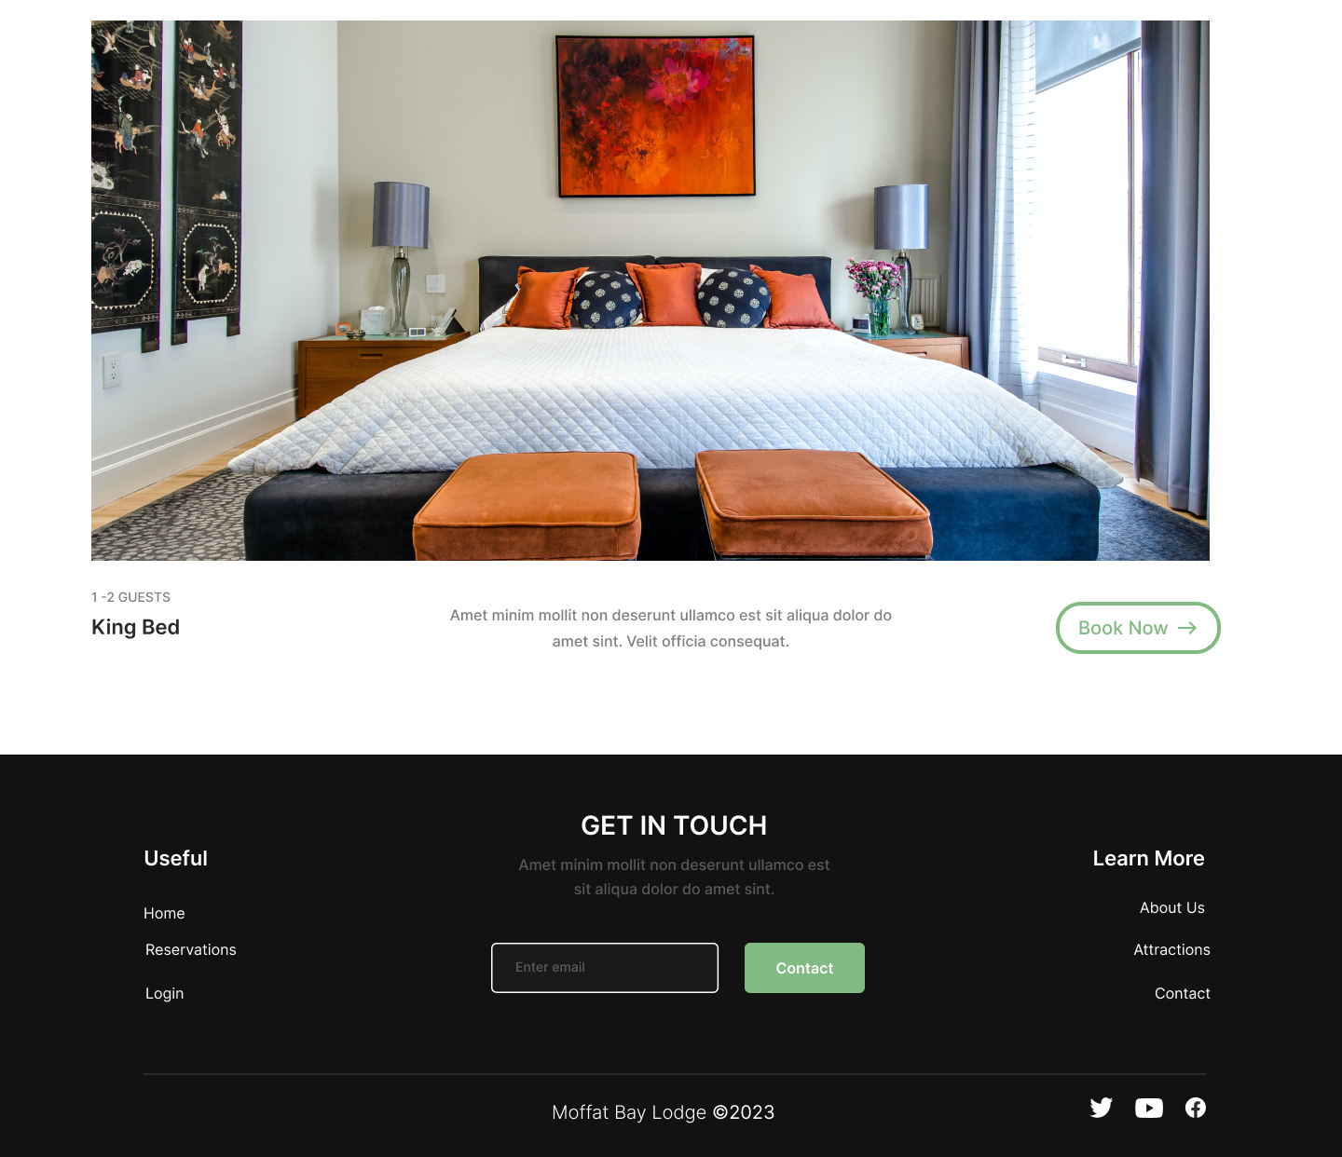
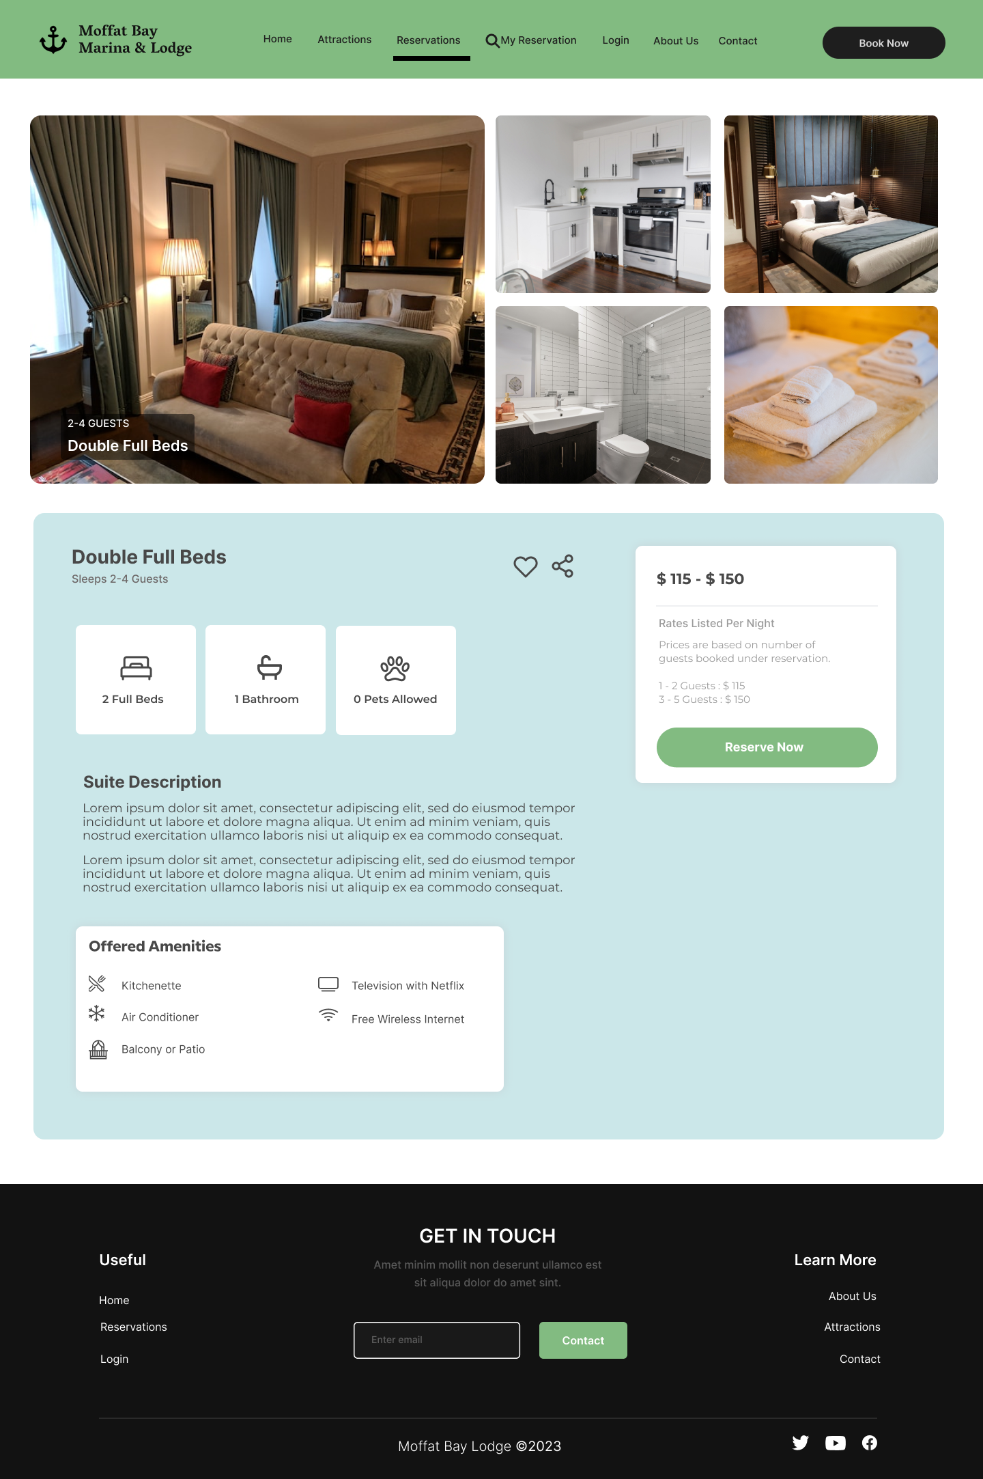
reservation page
This reservations page prototype offers a visual representation of the reservation system visitors will experience.
Key Elements & Design
Image Header with Call to Action: Featuring an inviting image of the lodge lobby and a compelling call to action encouraging users to book now.
Call to Action: Numerous “Book Now” buttons are displayed on the page, encouraging visitors to reserve a room.
Room Search Form: This form allows users to specify their desired dates and number of guests and search for a room. Clicking “Search Now” will return a list of available rooms based on their input.
List of Available Rooms: An attractive listing showcases all available rooms, complete with descriptions, room type labels, enticing images, and “Book Now” buttons.
Room Preview Page: When users click on a room, they are directed to a preview page. Featuring an image gallery, room information, amenities, and pricing.
Reserve Now Button: A prominent “Reserve Now” button prompts users to reserve the room they are viewing. Redirecting them to the reservation confirmation/summary page to confirm their booking.

Slide 11
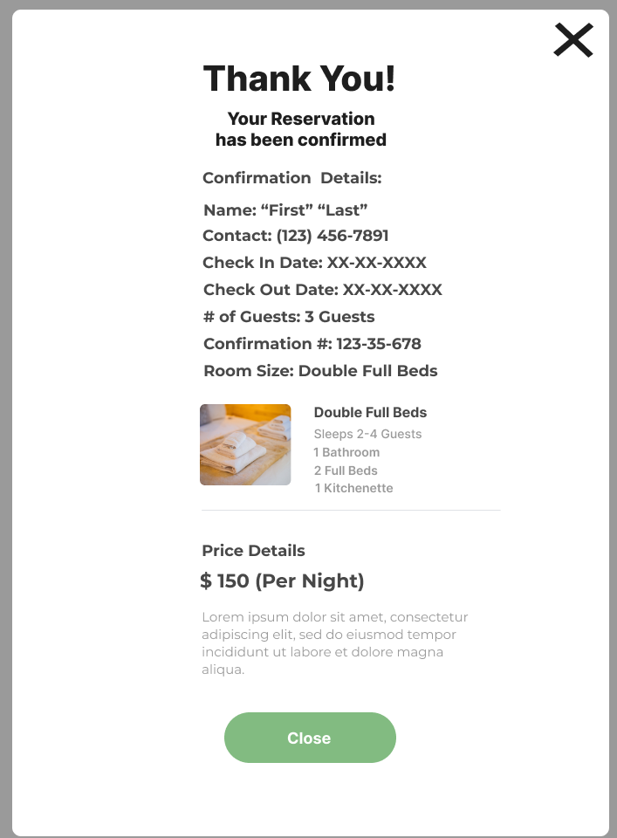
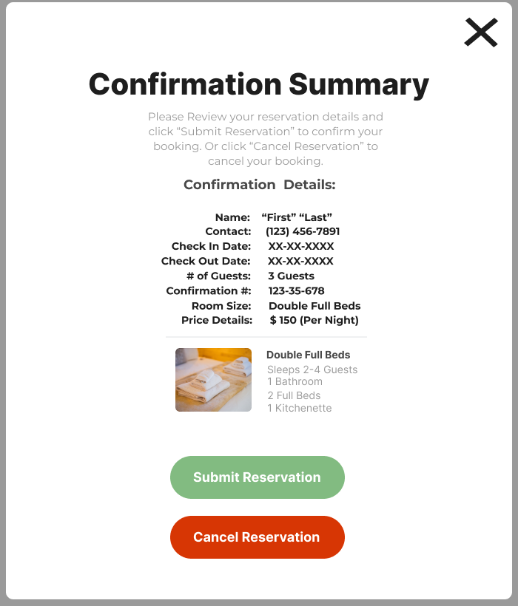
summary page
This summary page prototype demonstrates how users can review and confirm their reservation.
Key Elements & Design
Confirmation Summary: A confirmation summary, featuring informative text and clear labels. Instructions prompt users to review their requested reservation carefully before confirming. All pertinent reservation and room details are displayed in an easy-to-understand format.
Reservation Details: Details are prominently displayed, ensuring users have a comprehensive overview. Information includes contact details, check-in/out dates, number of guests, pricing, and room information.
Submit Button: The green “Submit Reservation” button encourages users to continue to confirm their reservation.
Cancel Button: The red “Cancel Reservation” button provides an option to cancel the process. Redirecting users to the reservations page to start over.
Confirmation Display: Upon submitting the reservation, users receive a thank you message. The message confirms their reservation and provides a unique confirmation key for reference as well as displaying all pertinent reservation details.

Slide 12
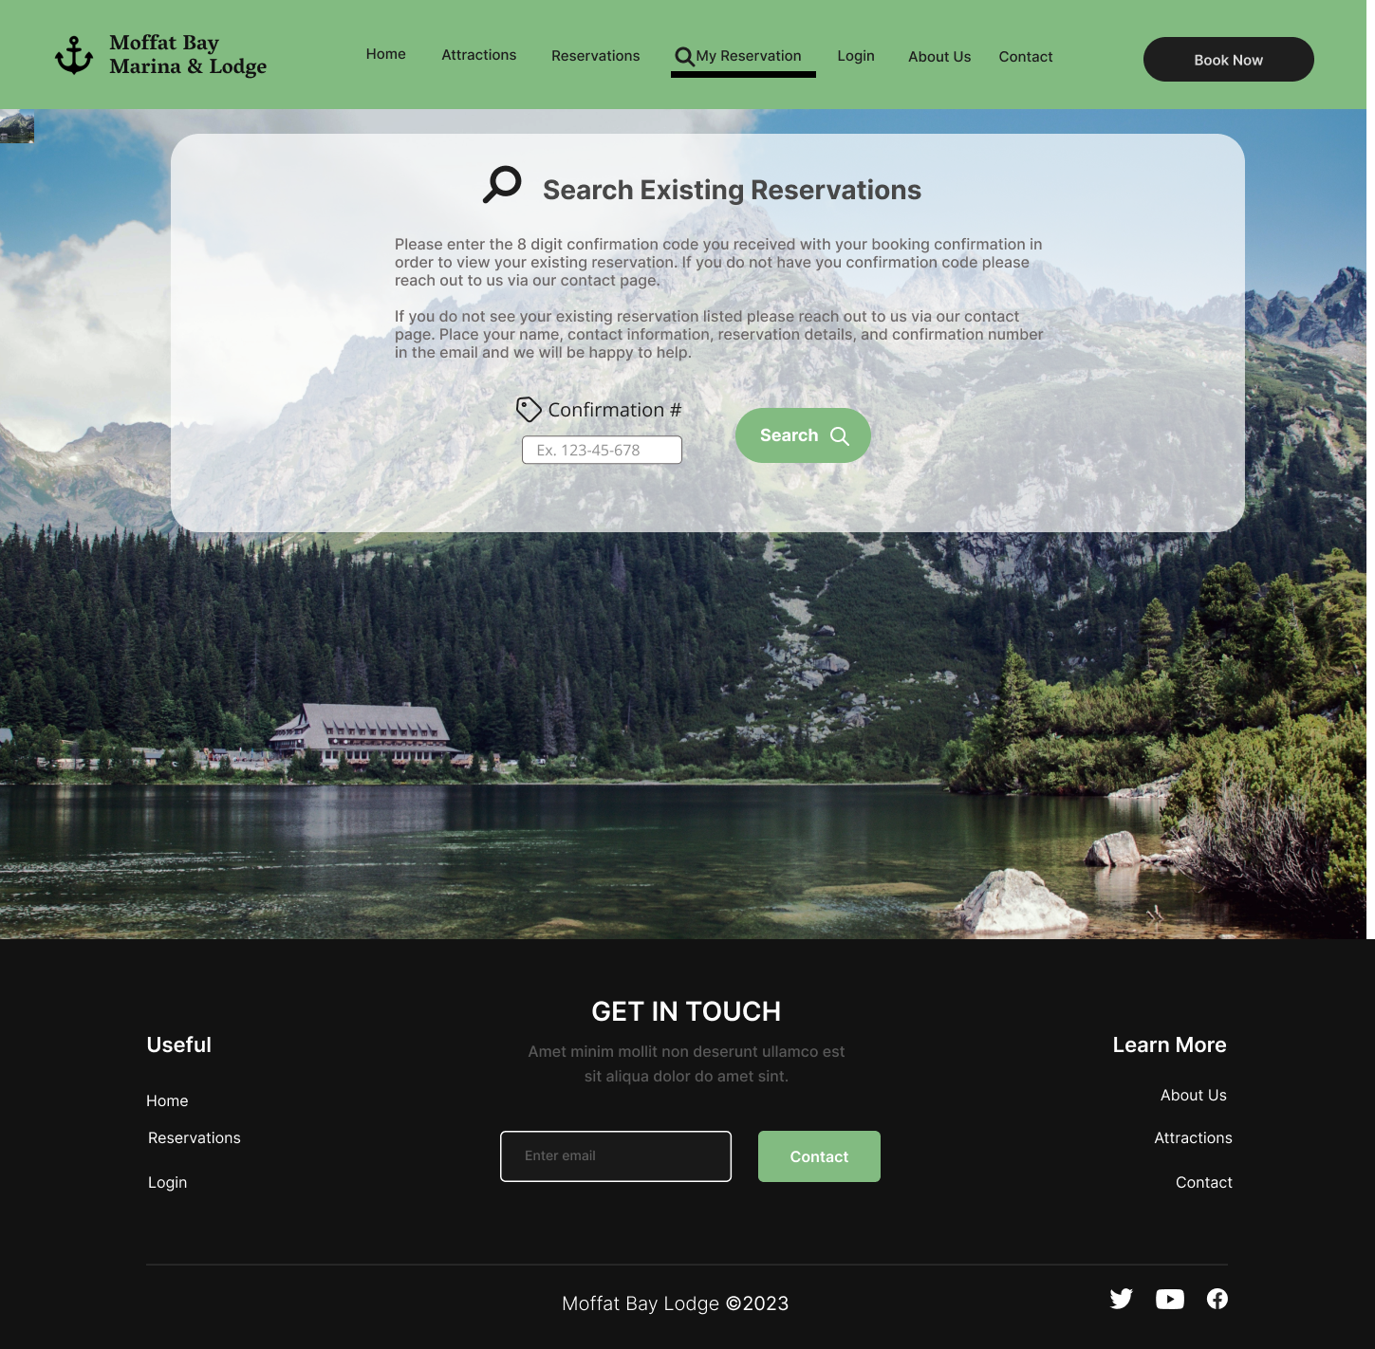
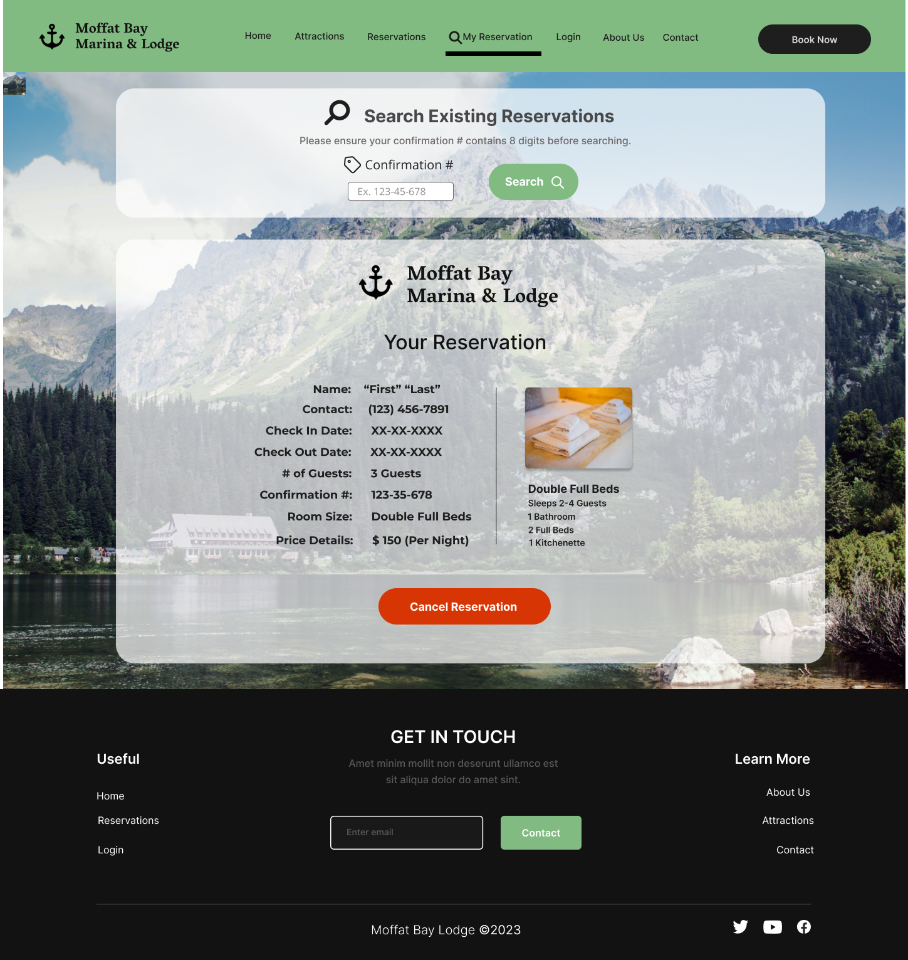
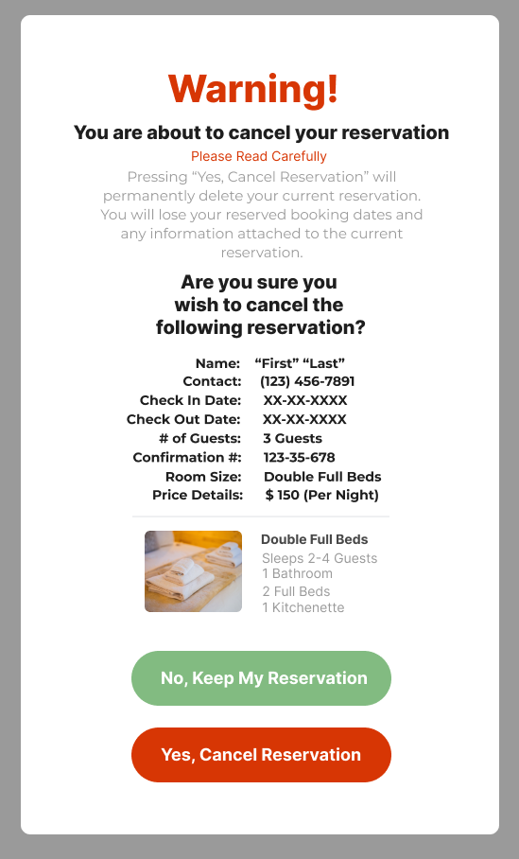
lookup page
This reservation lookup page prototype is designed to provide users with an easy and informative way to access their reservations.
Key Elements & Design
Labels & Input: The clear header label “Search Existing Reservations”, immediately informs users of the page’s purpose. Below informative instructions guide users on how to use the lookup by entering their confirmation number.
Search Entry Form: The entry from allows users to input their confirmation number. A prominent “Search” button is provided to submit their search and retrieve their details.
Returned Reservation Display: If found, the page displays the searched reservation in an organized and easy to read format. All pertinent reservation details are presented, including dates, room details, guests, price, and an image of the room.
Cancel Reservation Button: Users have the option to cancel/delete their reservation if they so choose. By clicking the “Cancel Reservation” button a confirmation box will prompt users to confirm or deny this action. This is intended to allow users to take action as needed and avoid error.

Slide 13
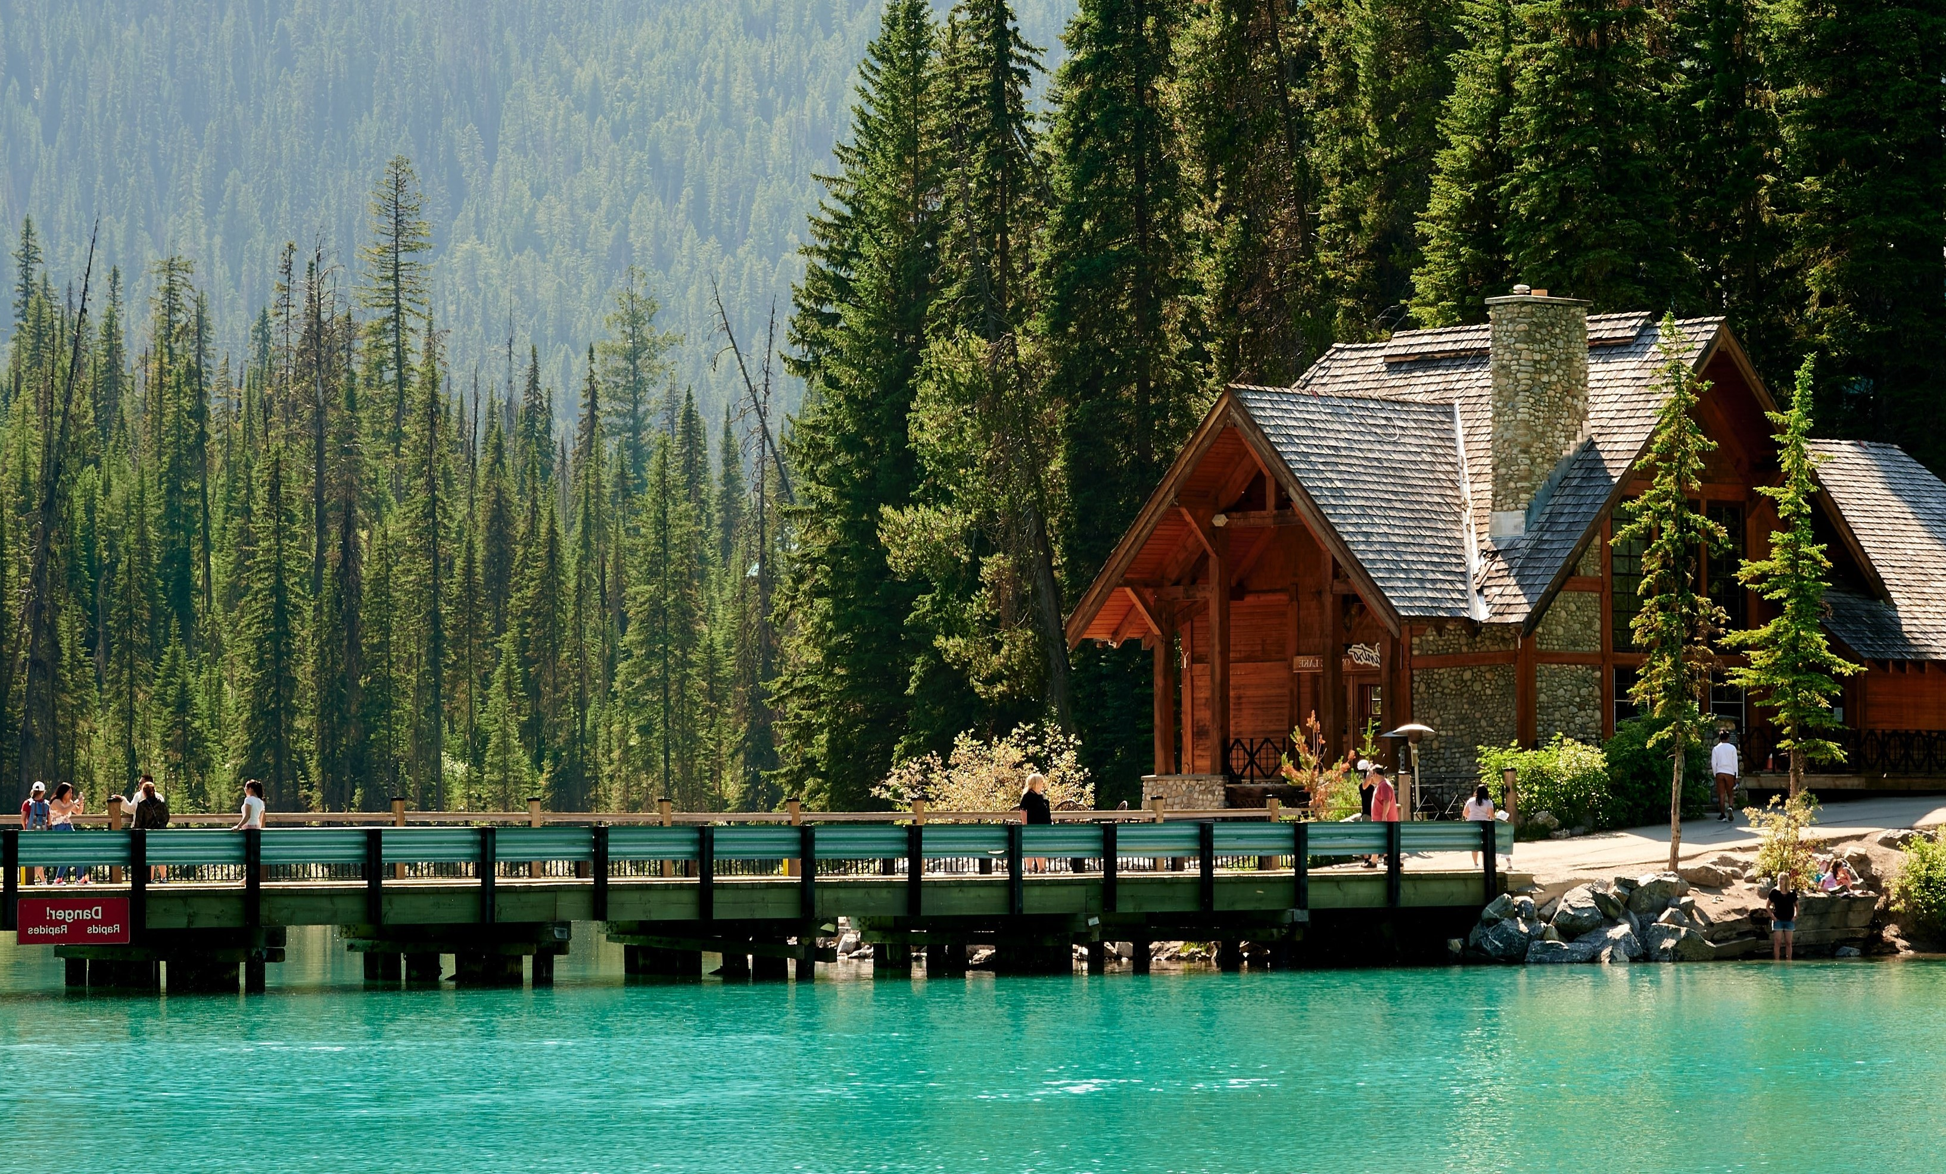
Moffat bay marina & lodge Entity Relationship Diagram (ERD)

Slide 14
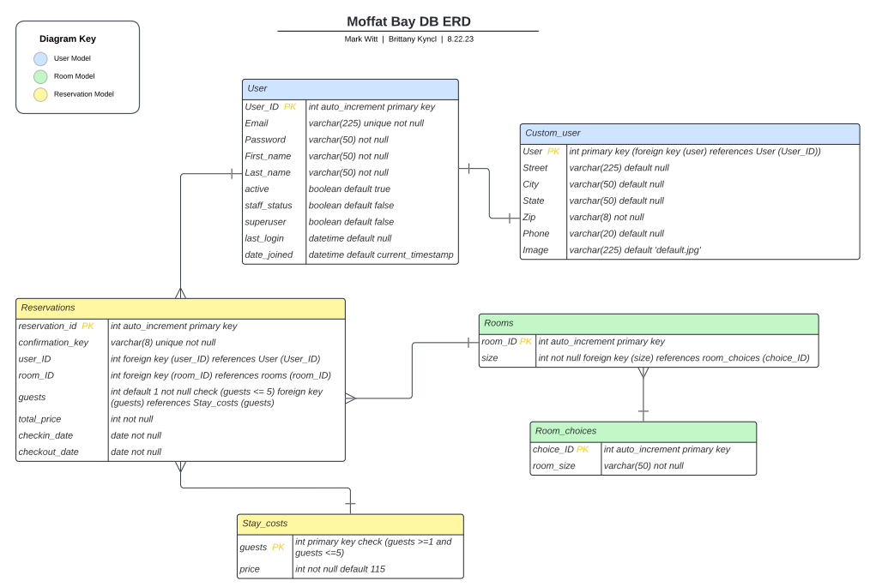

Slide 15
ERD - Diagram
PURPOSE & OVERVIEW
Our ERD, or Entity-Relationship Diagram, serves as the blueprint for the Moffat Bay website's backend database. It defines how data is structured, organized, and interconnected within the system. It serves as a visual map outlining the relationships between different entities such as rooms, users, reservations, and more.
User Entity: Represents users of the website with attributes like User_ID, Email, Password, First_name, Last_name, etc.
Custom_User Entity: Extends the User entity with additional details such as Street, City, State, Zip, Phone, and Image.
Room_Choices Entity: Represents various room size choices with attributes like choice_ID and room_size.
Rooms Entity: Represents individual rooms with attributes like room_ID and a foreign key reference to room_choices (size).
Stay_costs Entity: Represents stay costs based on the number of guests, with attributes guests and price.
Reservations Entity: Represents reservation details with attributes like reservation_id, confirmation_key, user_ID, room_ID, guests, total_price, checkin_date, and checkout_date.

Slide 16
ERD - Diagram
RELATIONSHIPS & CONSTRAINTS
User & Custom_User Relationship:
User profiles are extended with Custom_user details.
Custom_user references User_ID for user association.
Room_choices & Rooms Relationship:
Room size choices (Room_choices) are linked to individual rooms (Rooms)..
Rooms reference choice_ID for room size definition.
Stay_costs Constraints:
Stay costs are based on the number of guests.
Guests are constrained to a range of 1 to 5.
Specific prices are set for each guest count.
Reservations Relationships:
Reservations are associated with users and rooms.
User_ID links reservations to specific users.
Room_ID associates reservations with particular rooms.
Guests are linked to Stay_costs for accurate pricing.
Unique confirmation keys for each reservation.
Total price, check-in, and check-out dates are recorded.

Slide 17

Moffat bay marina & lodge Test cases

Slide 18
User Registration Form Functionality
Step | Action | Expected Results | Developer Pass/Fail | Tester Pass/Fail
1 | Navigate to localhost:8000/register | User Registration form should be displayed | Pass | Pass
2 | Enter new user account information, found in appendix I. | All fields should accept new user account information | Pass | Pass
3 | Click on the “Create Account” button | Website should redirect to login screen, and display login form, with a system message on the overlay, above the Moffat-Bay logo that reads: “User account has been created for Johnny Smith!” – indicating the user account was saved to the database | Pass | Pass
4 | Navigate to localhost:8000/admin | Admin page login screen should display | Pass | Pass
5 | Login with credentials: Email: **************Password: ******* | Administration page should display | Pass | Pass
6 | Click on the “Accounts” link, under the “Account Manager” heading | A list of user accounts should appear on the right of the page | Pass | Pass
7 | Locate the email address johnny@smith.com and click on the email address | An admin user account page should display, with all fields completed with the information entered in the registration form. This verifies the user account was saved to the database. | Pass | Pass
8 | Look for the password field | This should display the following information: algorithm, iterations, salt, and hash. Salt and hash should have most of the characters as **********. This verifies the user password is stored as a hash and cannot be viewed/changed, also verifying password integrity/security. | Pass | Pass
9 | Scroll to the bottom of the page | A red delete button should be displayed on the bottom right of the page | Pass | Pass
10 | Click on the red delete button | A delete user confirmation page should display | Pass | Pass
11 | Click on the red “yes, I’m sure” button | Page should redirect to the list of user accounts. | Pass | Pass
12 | Verify johnny@smith.com is no longer in the user account list | Johnny@smith.com user account was removed. This verifies the admin functions of the user accounts. | Pass | Pass
TEST CASE EXAMPLE 1
Test Objective:
Test the User Registration Form, ensuring it saves new user information correctly.
Comments:
User registration is well styled and keeps the same theme and flow of the overall site.
Functionality of the registration works well and is easy to follow.

Slide 19
Reservation System availability search pathway
Step | Action | Expected Results | Developer Pass/Fail | Tester Pass/Fail
1 | Navigate to localhost:8000/start-booking/ | Moffat-Bay Registration page should be displayed | Pass | Pass
2 | On the “Search Now” form, select 2 dates and 3 guests. The check-in date must be after today’s date. And the check-out date must be after the check-in date. | Available rooms page should load, displaying your chosen dates and guests. | Pass | Pass
3 | Scroll down to view available rooms | Each room size should also include a room number, indicating this room is available. | Pass | Pass
4 | Scroll to the bottom, to the king-size room, and click the “book now” button | Login page should be displayed | Pass | Pass
5 | Enter Credentials found in Appendix I | Reservation Summary page should display, with the price per night, total cost, and all input details of the reservation so far. | Pass | Pass
6 | Click on the green “Confirm Reservation” button. Upon the new page loading, write down the reservation number: 1043________ | Reservation Confirmation Summary page should be displayed, and your summary should also now include a reservation number and confirmation number | Pass | Pass
7 | Navigate to localhost:8000/admin | A login form should appear | Pass | Pass
8 | Enter the credentials: Email: ************** Password: ********* | Login should be successful, and the administration page should display with the options: Account Manager, Lodge Room Manager, Reservation Manager | Pass | Pass
9 | Under Reservation Manager, click on the “Guest Reservations” link | A list of reservations should display. | Pass | Pass
10 | In the search bar above the list of reservations, type in the confirmation number given to you in step 6 | The list of reservations should change and only display search results | Pass | Pass
11 | Click on the reservation to view the details of that reservation | A reservation details page should display, containing all details of the reservation you just made. This ensures the reservation was saved to the database. | Pass | Pass
TEST CASE EXAMPLE 2
Test Objective:
Test the reservation system by utilizing the availability search form.
Comments:
Booking a reservation through this path is very easy and straightforward.
All features are functional.
Suggestion: Add a message to the login screen asking users to either log in or create an account to continue booking.

Slide 20
Reservation confirmation & cancel function
Step | Action | Expected Results | Developer Pass/Fail | Tester Pass/Fail
1 | Navigate to the reservations page, enter check-in/check-out dates, and the number of guests into the search form. Take note of the reservation dates and the number of guests. | The form should allow date selection and the number of guests selection. Then display your selections before clicking the “search now” button. | Pass | Pass
2 | Click the “search now” button to submit the search form. | Navigated to the available rooms page with the entered form information displayed. | Pass | Pass
3 | Select an available room and press the “book now” button. | Should be navigated to the reservation summary page with the corresponding room and reservation details displayed. | Pass | Pass
4 | Navigate to the reservations page, enter check-in/check-out dates, and the number of guests into the search form. Take note of the reservation dates and the number of guests. | The form should allow date selection and the number of guests selection. Then display your selections before clicking the “search now” button. | Pass | Pass
5 | Click the green “confirm reservation” button. | Navigated to the confirmation summary page displaying a confirmation message. | Pass | Pass
6 | Read through the confirmation summary information to verify the details. | The reservation confirmation information should match that of the submitted reservation from the previous page, including the total cost, dates, room, number of guests, and contact information. | Pass | Pass
7 | Look at the bottom of the confirmation summary for unique identifiers for the reservation. | A 4-digit unique reservation number should be displayed in blue bold. A unique 7-digit alphanumeric confirmation # should be generated and displayed. | Pass | Pass
8 | Press the green “back to home” button. | Should be navigated back to the landing page. | Pass | Pass
9 | Repeat steps 1-4 to create a new reservation and view the reservation summary page. | A new reservation summary should be displayed with correct information. A confirmation and cancel button should be presented. | Pass | Pass
10 | Press the red “cancel, go back!” button. | Current reservation should be cleared, and the user navigated back to the reservations page to start a new reservation. | Pass | Pass
TEST CASE EXAMPLE 3
Test Objective:
Verify that the "Cancel Reservation" button on the confirmation summary page functions correctly.
Comments:
Overall, the test actions and their results indicate that the reservation confirmation summary page and related functionalities are working correctly, providing a positive user experience and accurate reservation handling.

Slide 21
Delete reservation functionality
Step | Action | Expected Results | Developer Pass/Fail | Tester Pass/Fail
1 | Navigate to localhost:8000/my-reservations/ | Search existing reservations form should display | Pass | Pass
2 | Enter the code: 5E8FF18 into the search bar and click the “search now” button | Another overlay should appear below the search form, showing the reservation details for the searched confirmation # | Pass | Pass
3 | Under the reservation details, click on the “delete reservation” button | A pop-up should appear asking to confirm deleting the reservation | Pass | Pass
4 | Click on ‘yes, delete reservation’ button | Reservation search page should reload, with a message that the reservation is deleted successfully | Pass | Pass
5 | Search again for confirmation #: 5E8FF18 | Reservation search should not return any results | Pass | Pass
1 | Navigate to localhost:8000/my-reservations/ | Search existing reservations form should display | Pass | Pass
2 | Enter the code: 5E8FF18 into the search bar and click the “search now” button | Another overlay should appear below the search form, showing the reservation details for the searched confirmation # | Pass | Pass
3 | Under the reservation details, click on the “delete reservation” button | A pop-up should appear asking to confirm deleting the reservation | Pass | Pass
4 | Click on ‘yes, delete reservation’ button | Reservation search page should reload, with a message that the reservation is deleted successfully | Pass | Pass
5 | Search again for confirmation #: 5E8FF18 | Reservation search should not return any results | Pass | Pass
TEST CASE EXAMPLE 4
Test Objective:
Test to ensure the delete reservation feature functions correctly.
Comments:
Delete reservation function is user-friendly, and the pop-up confirmation adds to the user experience.
The delete function works as intended, and reservations are successfully removed from the system.

Slide 22
Link functionality on activities page
Step | Action | Expected Results | Developer Pass/Fail | Tester Pass/Fail
1 | Navigate to localhost:8000/local-attractions/ | Attractions Page should display | Pass | Pass
2 | Scroll down to the Kayaking section, and click on the “Book your Stay” button | Start of Booking page should display, with the search availability form present | Pass | Pass
3 | On the header navigation bar, click on the “Attractions” link | Attractions Page should display | Pass | Pass
4 | Scroll down to the Scuba Diving section, and click on the “Book your Stay” button | Start of Booking page should display, with the search availability form present | Pass | Pass
5 | In the Footer navigation links, click on the “Attractions” link | Attractions Page should display | Pass | Pass
6 | Scroll down to the Guided Hiking Tours section, and click on the “Book your Stay” button | Start of Booking page should display, with the search availability form present | Pass | Pass
7 | On the header navigation bar, click on the “Attractions” link | Attractions Page should display | Pass | Pass
8 | Scroll down to the Whale Watching section, and click on the “Book your Stay” button | Start of Booking page should display, with the search availability form present | Pass | Pass
TEST CASE EXAMPLE 5
Test Objective:
Test to ensure that links on the Activities Page function correctly.
Comments:
All links are working correctly and redirect to the appropriate pages.
The styling of the buttons on the Attractions Page and throughout the site blends seamlessly with the site's theme, enhancing the user experience.

Slide 23
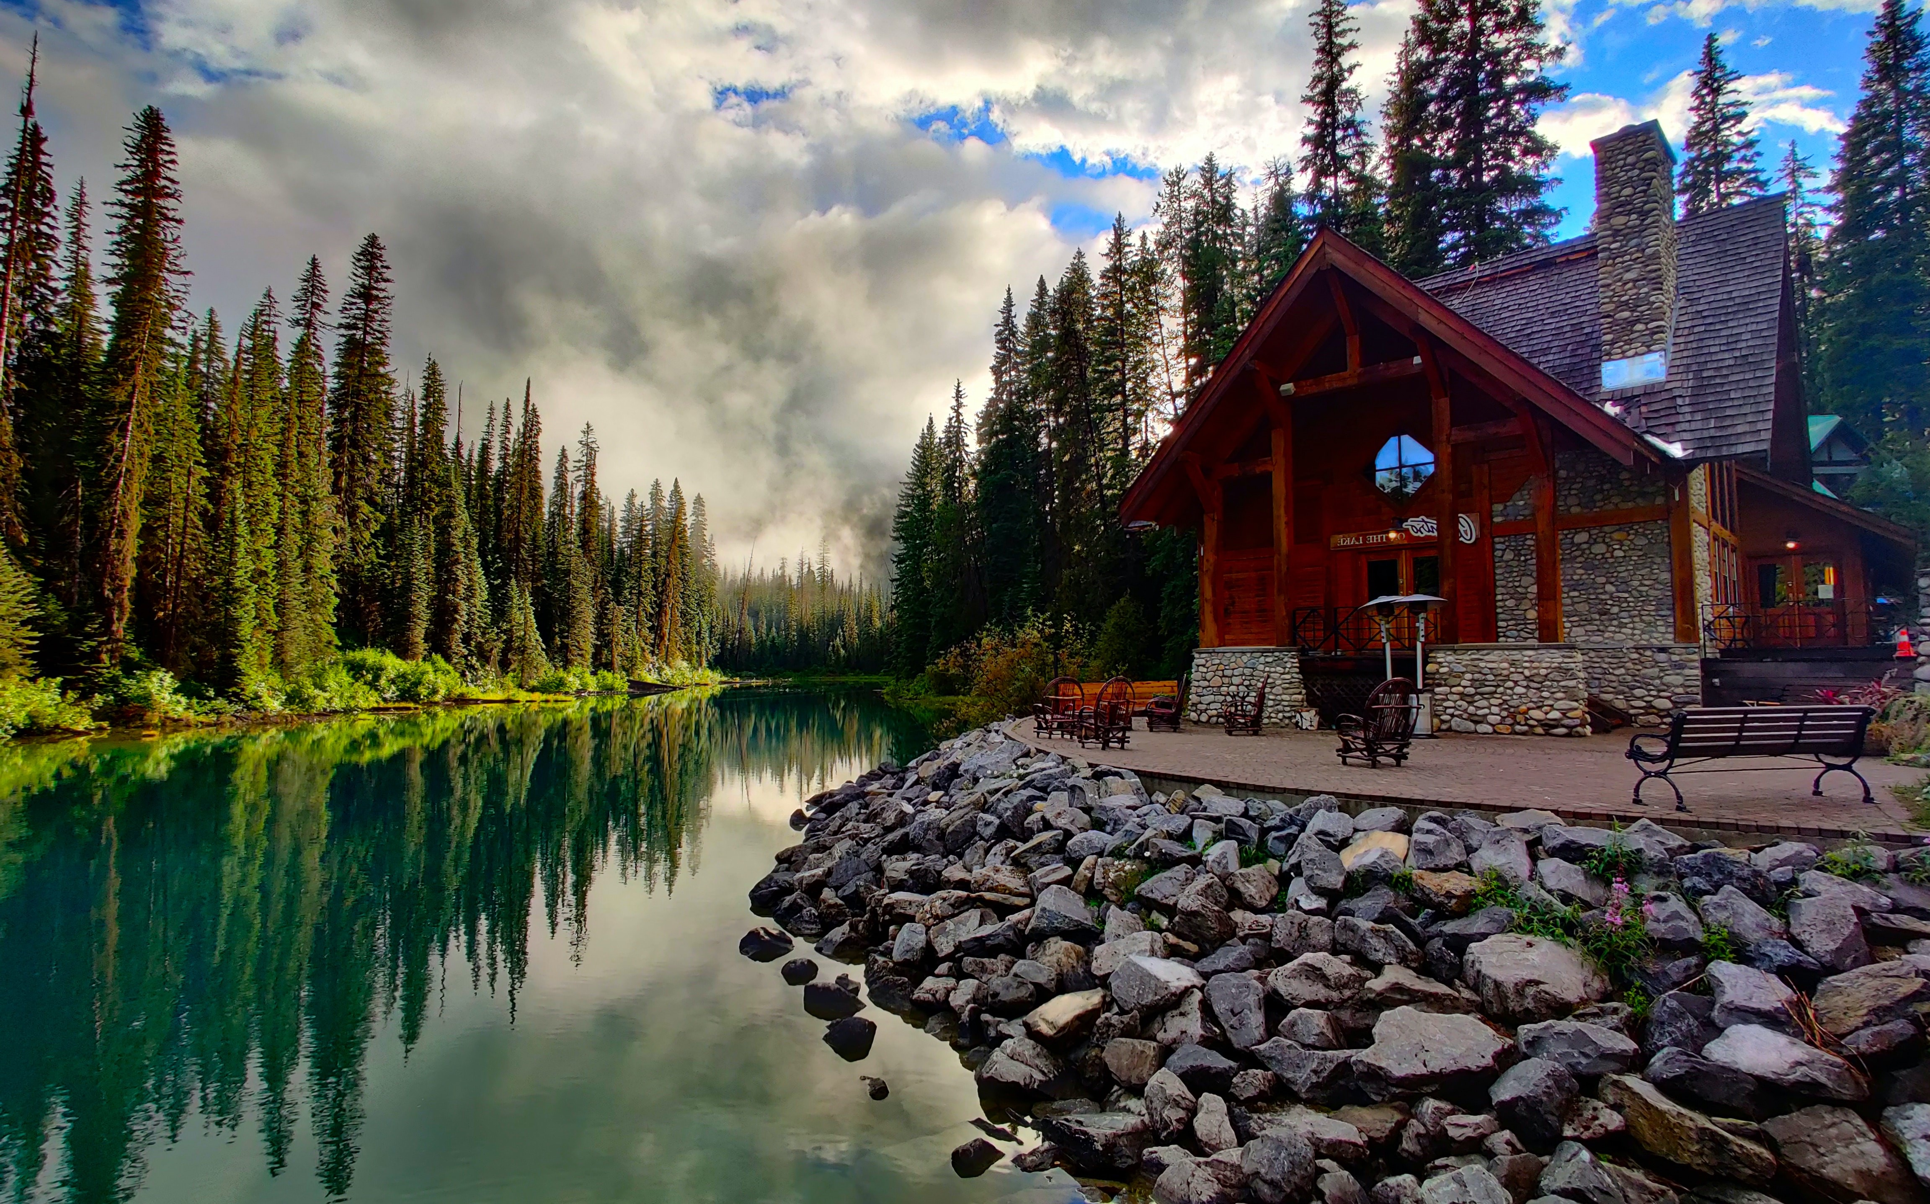
Moffat bay marina & lodge lessons learned

Slide 24

A LEARNING EXPERIENCE
PROJECT MANAGEMENT
We learned the importance of effective project planning at every stage. Such as diagraming, prototyping, and scaffolding our site.
It’s imperative to plan out scheduling, task allocation, and to set aside dedicated time for last minute changes.
PROBLEM SOLVING
We learned the value of adaptability in being able to find creative solutions to tricky problems.
The importance of implementing problem solving strategies such as divide and conquer to more efficiently fix issues.
TIME MANAGEMENT
We learned that effective time management practices are imperative to success.
It’s important to not let time constraints become a barrier to effective decision making.

Slide 25
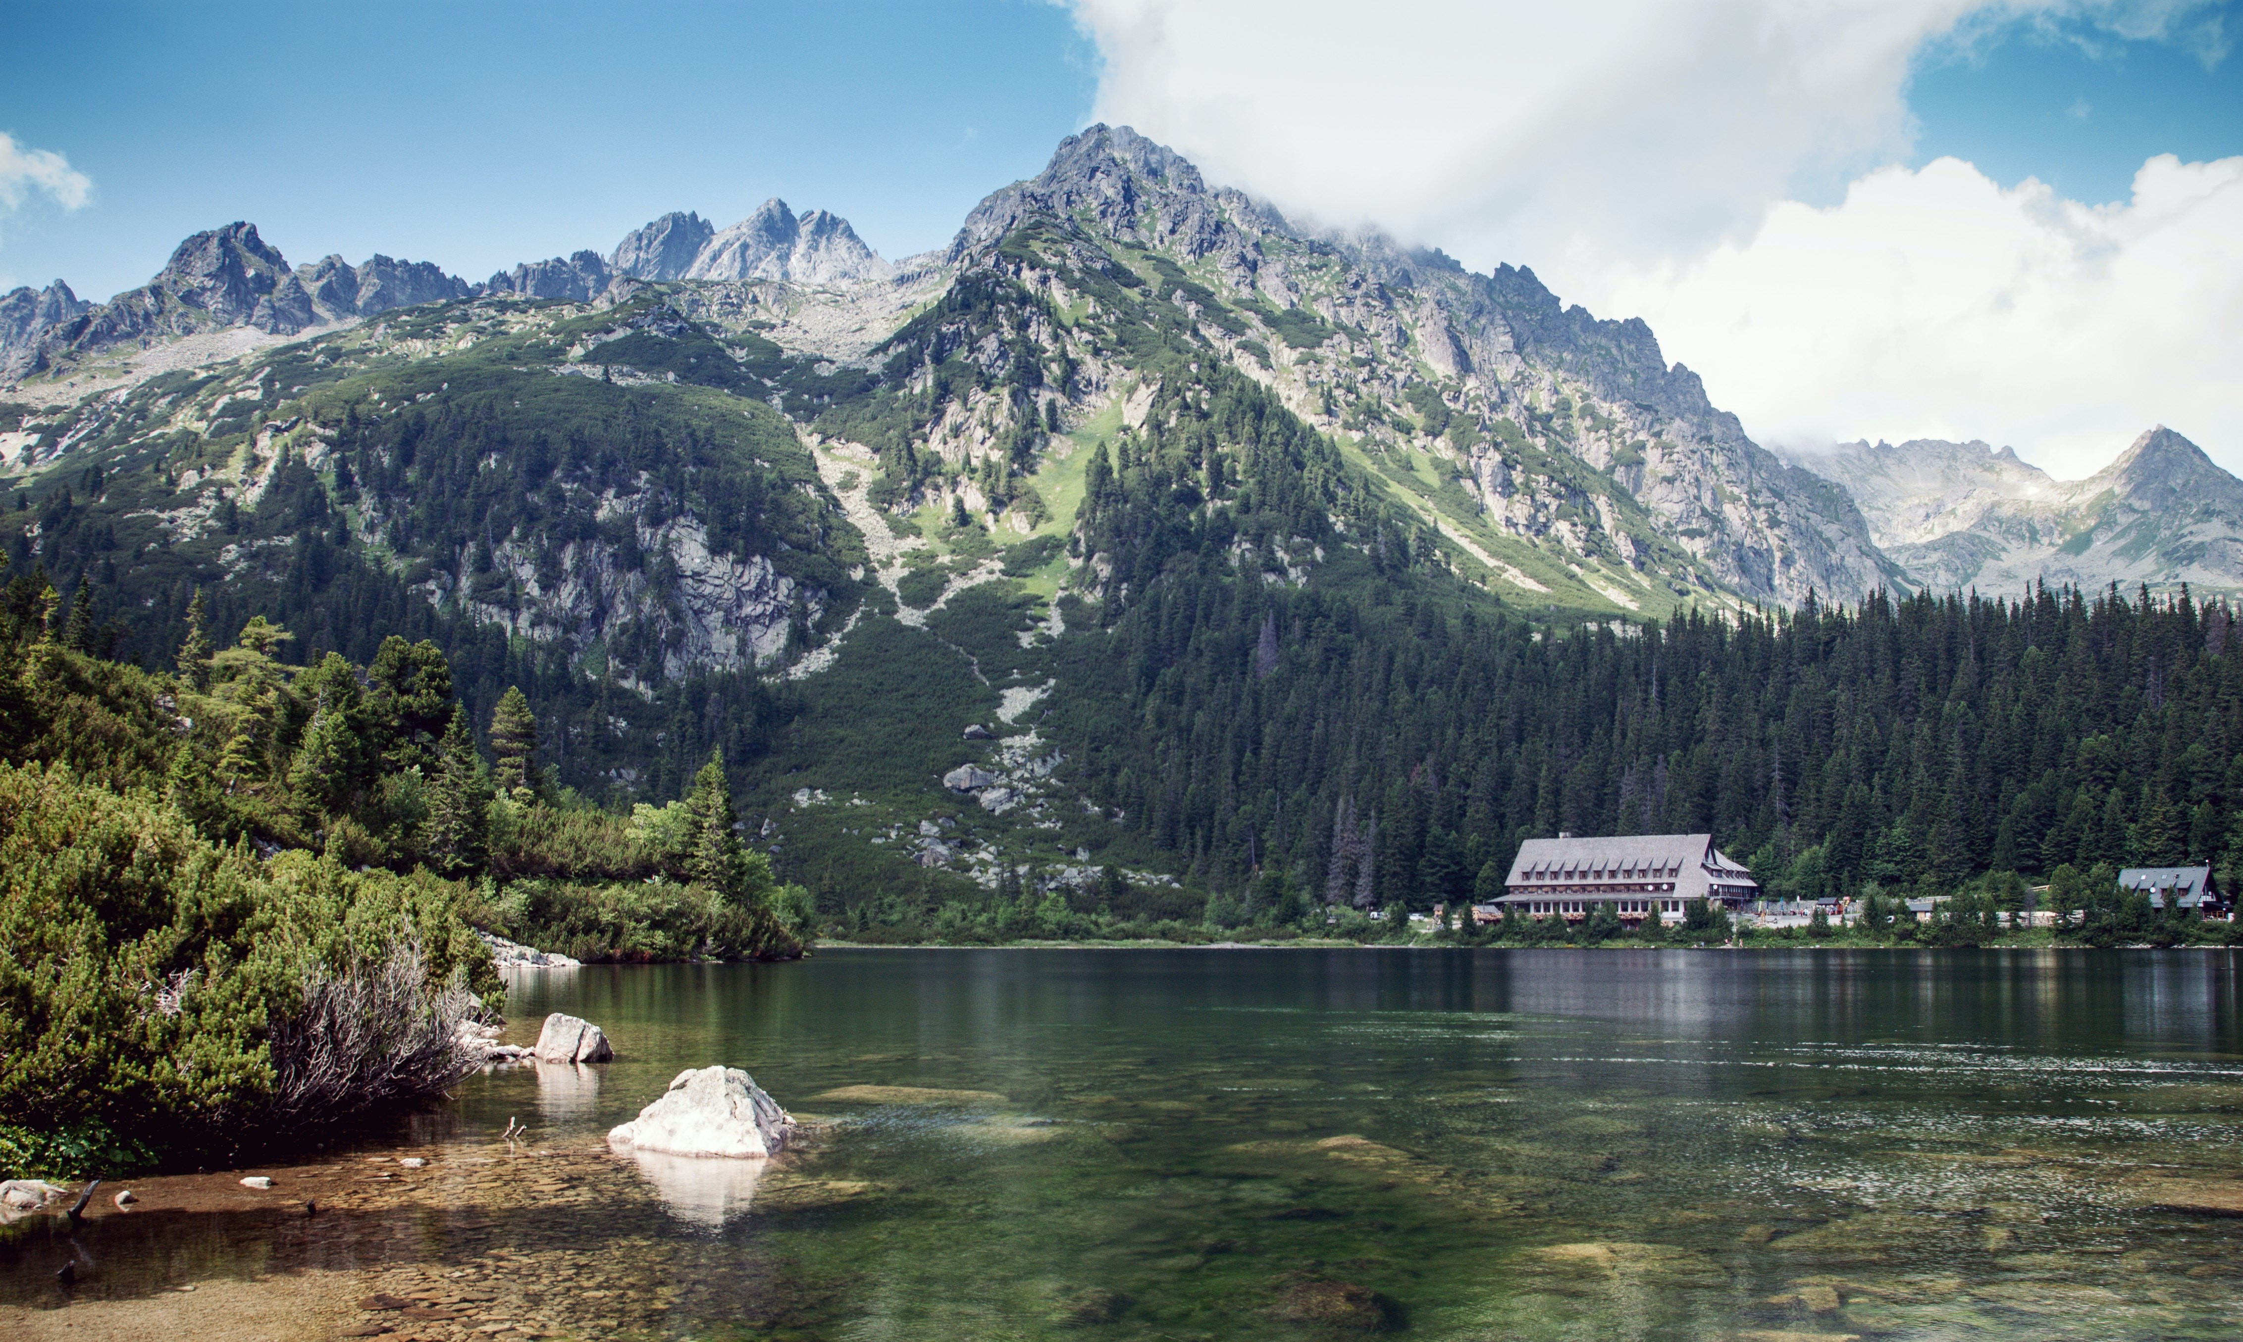
THANK YOU BRAVO TEAM Brittany Kyncl & Mark Witt
To see it in action Explore the live site here…
HTTPS://MOFFAT-BAY.ORG/

